Slide 1
AUTOMATIC COLOUR SORTER using arduino nano
By
Shreenath
Xavier
Rohan
Akshay

Slide 2
Agenda
Introduction
Project Model
Processing steps with program
Circuit diagram
Hardware contents
Software specification
Application

Slide 3
INTRODUCTION
COLOUR SORTER HAS BEEN USED IN INDUSTRY FOR SORTING OF GRAIN
IT IS USED FOR LARGE SCALE SORTING
IN THIS PROJECT WE HAVE MADE A BASIC MODEL OF COLOUR SORTER IN WHICH A COLOUR SENSOR RETURN A RGB VALUE FOR FURTHER PROCESSING
THE SERVO MOTORS ARE THEN USED TO SORT THE GEMS

Slide 4
PROJECT MODEL
ARDUINO COLOUR SORTER

Slide 5
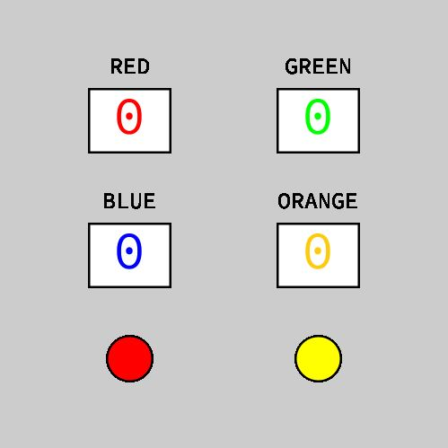
DASHBOARD

Slide 6
PROCESSING STEPS
Initially, the colored gems which are held in the charger drop into the platform attached on the top servo motor.
Then the servo motor rotates and brings the skittle to the colour sensor which detects its colour.
After that the bottom servo motor rotates to the particular position and then the top servo motor rotates again till the skittle drop into the guide rail.
It is then interfaced to the computer

Slide 7
Program blocks
Sensors
Actuators
DCS 3200 COLOUR SENSOR
Top servo
Bottom servo

Slide 8
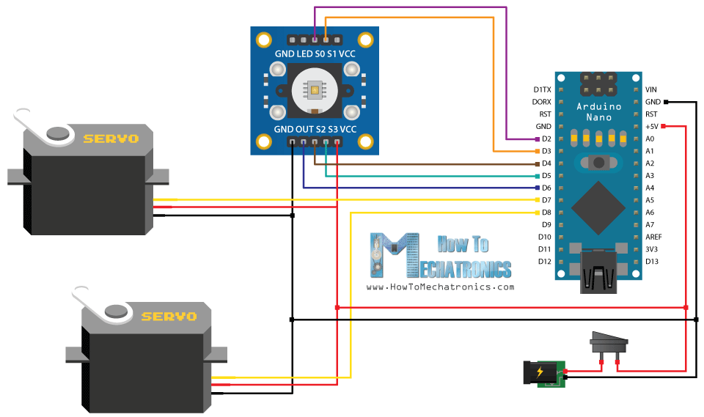
Circuit Diagram

Slide 9
Hardware contents
Arduino Nano
Colour Sensor DCS3200
Servo Motors sg90
Connecting Wires
Perforated PCB

Slide 10
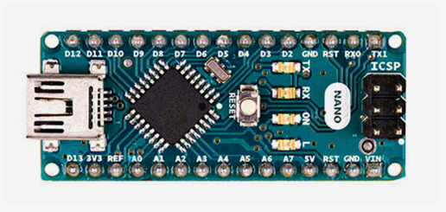
Arduino nano
The Arduino Nano is a small, complete, and breadboard-friendly board based on the ATmega328 (Arduino Nano 3.x). It has more or less the same functionality of the Arduino Duemilanove, but in a different package. It lacks only a DC power jack, and works with a Mini-B USB cable instead of a standard one.

Slide 11
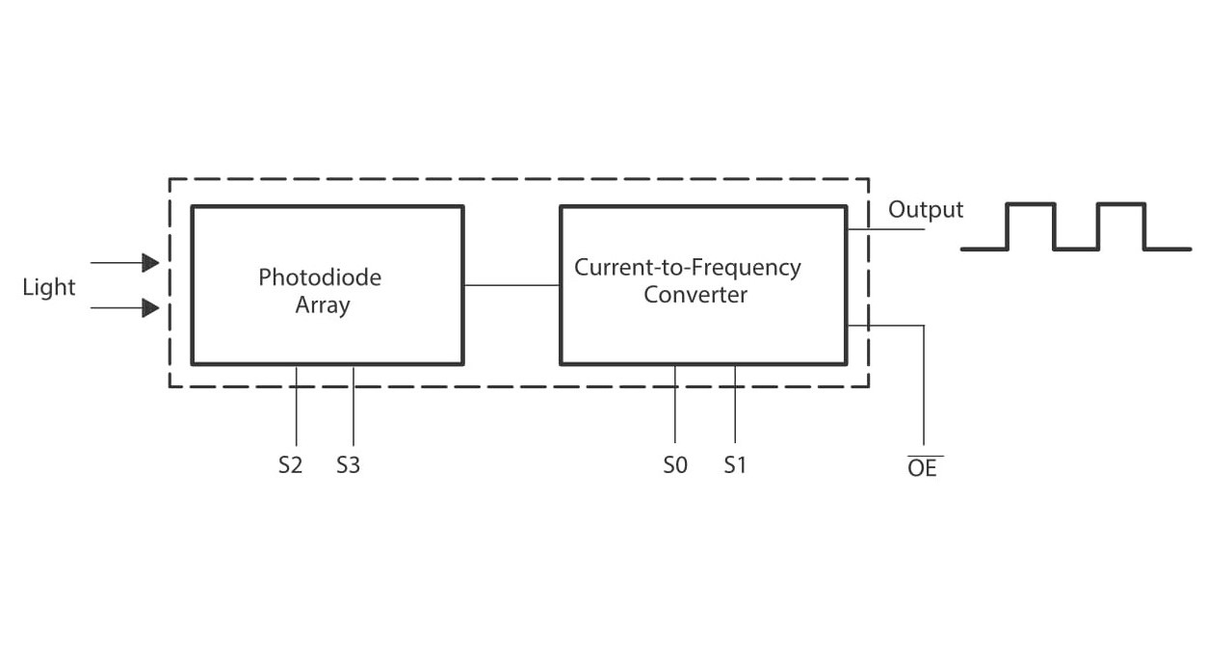
BLOCK DIAGRAM
COLOUR SENSOR DCS3200

Slide 12
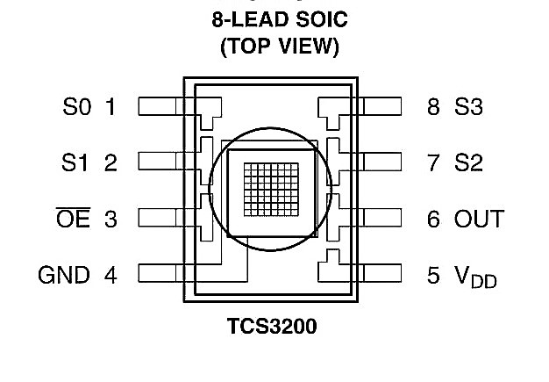
PIN DIAGRAM OF DCS3200

Slide 13
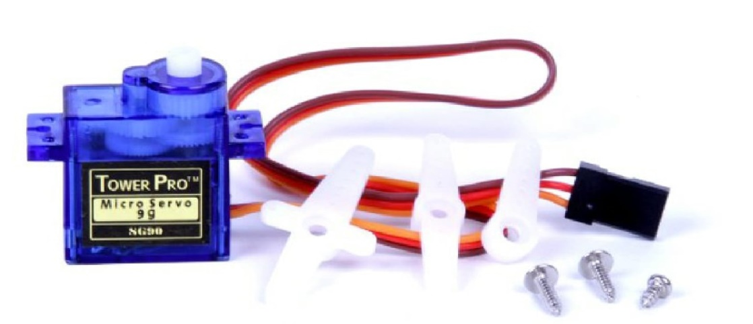
Servo motor sg90
Tiny and lightweight with high output power. Servo can rotate approximately 180 degrees (90 in each direction), and works just like the standard kinds but smaller. You can use any servo code, hardware or library to control these servos. Good for beginners who want to make stuff move without building a motor controller with feedback & gear box, especially since it will fit in small places. It comes with a 3 horns (arms) and hardware..

Slide 14
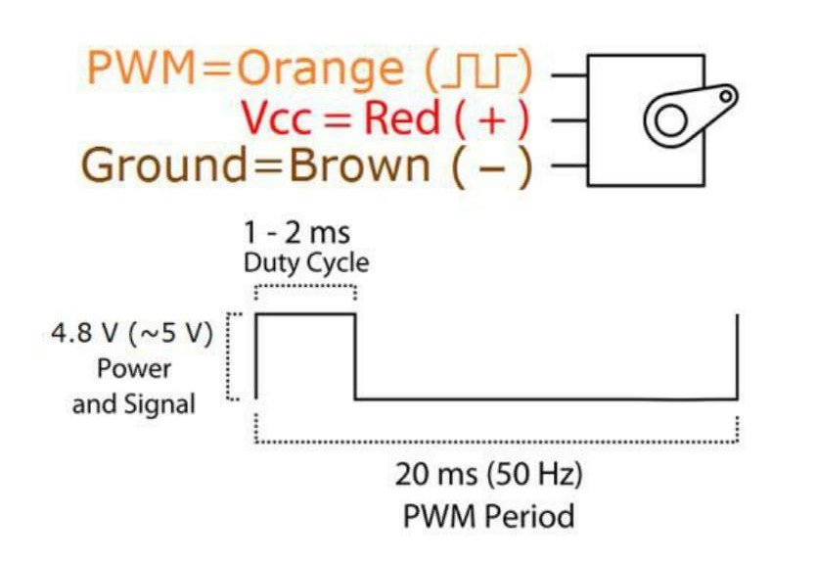
Wiring diagram of sg90

Slide 15
Application
Colour sensor is widely used in the industry.
Its widely used application is in sorting grain industry.
Its is used to detect the defect in products.

Slide 16
DOUBTS AND QUERIES

Slide 17
Thank you

